Slide 1
Railway Reservation System

Slide 2
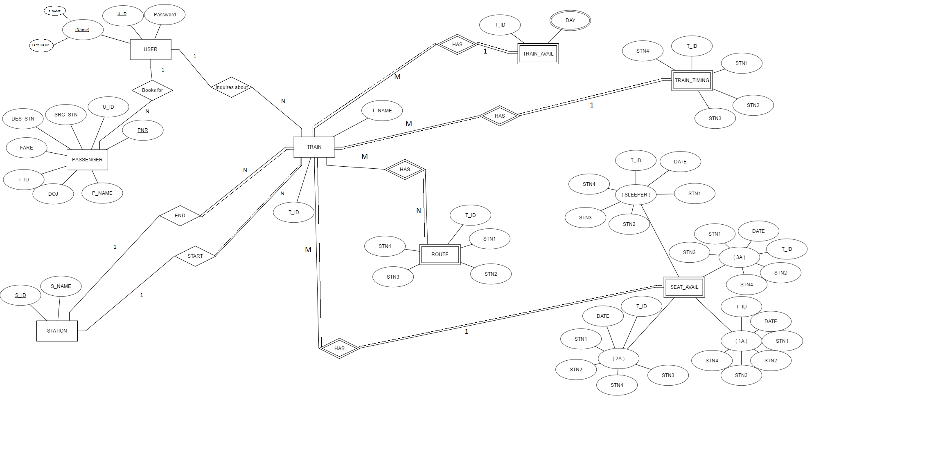
E R Diagram

Slide 3

USER TABLE
Composite attribute
U_ID | NAME | PASSWORD
U_ID | PASSWORD
U_ID | F_NAME | L_NAME
U_ID -> PASSWORD U_ID->(F_NAME,L_NAME)

Slide 4
Passenger Table
U_ID | PNR | PNAME | DOJ | T_ID | FARE | SRC | DEST
U_ID | PNR
PNR | PNAME | DOJ | T_ID | FARE | SRC | DEST
Here U_ID -> ( P_NAME, DOJ, T_ID, FARE, SRC, DEST ) leads to Transitive dependency as U_ID -> PNR and PNR -> ( P_NAME, DOJ, T_ID, FARE, SRC, DEST ). So It is in 3NF Form .

Slide 5
Train Table
T_ID | T_NAME
12295 | Sangmitra Express
Station Table
S_ID | S_NAME
SBC | Bangalore Central

Slide 6
Train_Avail Table
Not in 1NF FORM
T_ID | DAY
12295 | MONDAY , THURSDAY, SATURDAY
T_ID | DAY
12295 | Monday
12295 | Thursday
12295 | Saturday

Slide 7
Train_Timing Table
T_ID | STN1 | STN2 | STN3 | STN4
12295 | 6:00 | 12:40 | 14:50 | 1:00
Route Table
T_ID | STN1 | STN2 | STN3 | STN4
12295 | PNBE | ALD | NAG | SBC

Slide 8
Seat_Avail
1 A
T_ID | DATE | STN1 | STN2 | STN3 | STN4
12295 | 30/12/2016 | 25 | 25 | 25 | 25
→ For 1st class AC , maximum seat Availability is 25 .

Slide 9
Seat_Avail
2 A
T_ID | DATE | STN1 | STN2 | STN3 | STN4
12295 | 30/12/2016 | 50 | 50 | 50 | 50
→ For 2nd class AC , maximum seat Availability is 50 .

Slide 10
Seat_Avail
3 A
T_ID | DATE | STN1 | STN2 | STN3 | STN4
12295 | 30/12/2016 | 75 | 75 | 75 | 75
→ For 3rd class AC , maximum seat Availability is 75 .

Slide 11
Seat_Avail
Sleeper Class
T_ID | DATE | STN1 | STN2 | STN3 | STN4
12295 | 30/12/2016 | 150 | 150 | 150 | 150
→ For Sleeper class AC , maximum seat Availability is 150.

Slide 12
Thanks !

